Slide 1
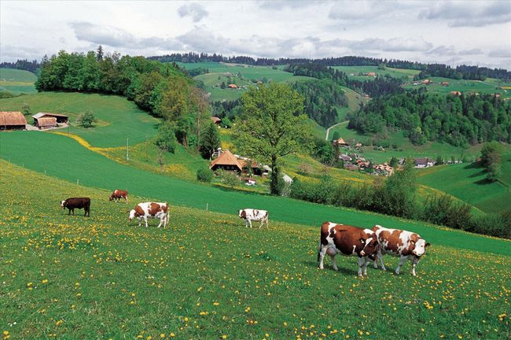

2020
HKSCAN

Slide 2


Introduction
In today's big data era, we need to make use of data to introduce our product advantages to our customers. We have noticed that the food industry must provide consumers with more accurate and open data, and it is necessary to let customers know more about our transparent production line and provide safe products.

Slide 3
For consumers
Accurate & transparent
Analyze needs
Split process
Pinpoint location
Insert animation
of production.
Cc
Accumulate consumption
Speculate
more need
Implementation
Plan idea

Slide 4
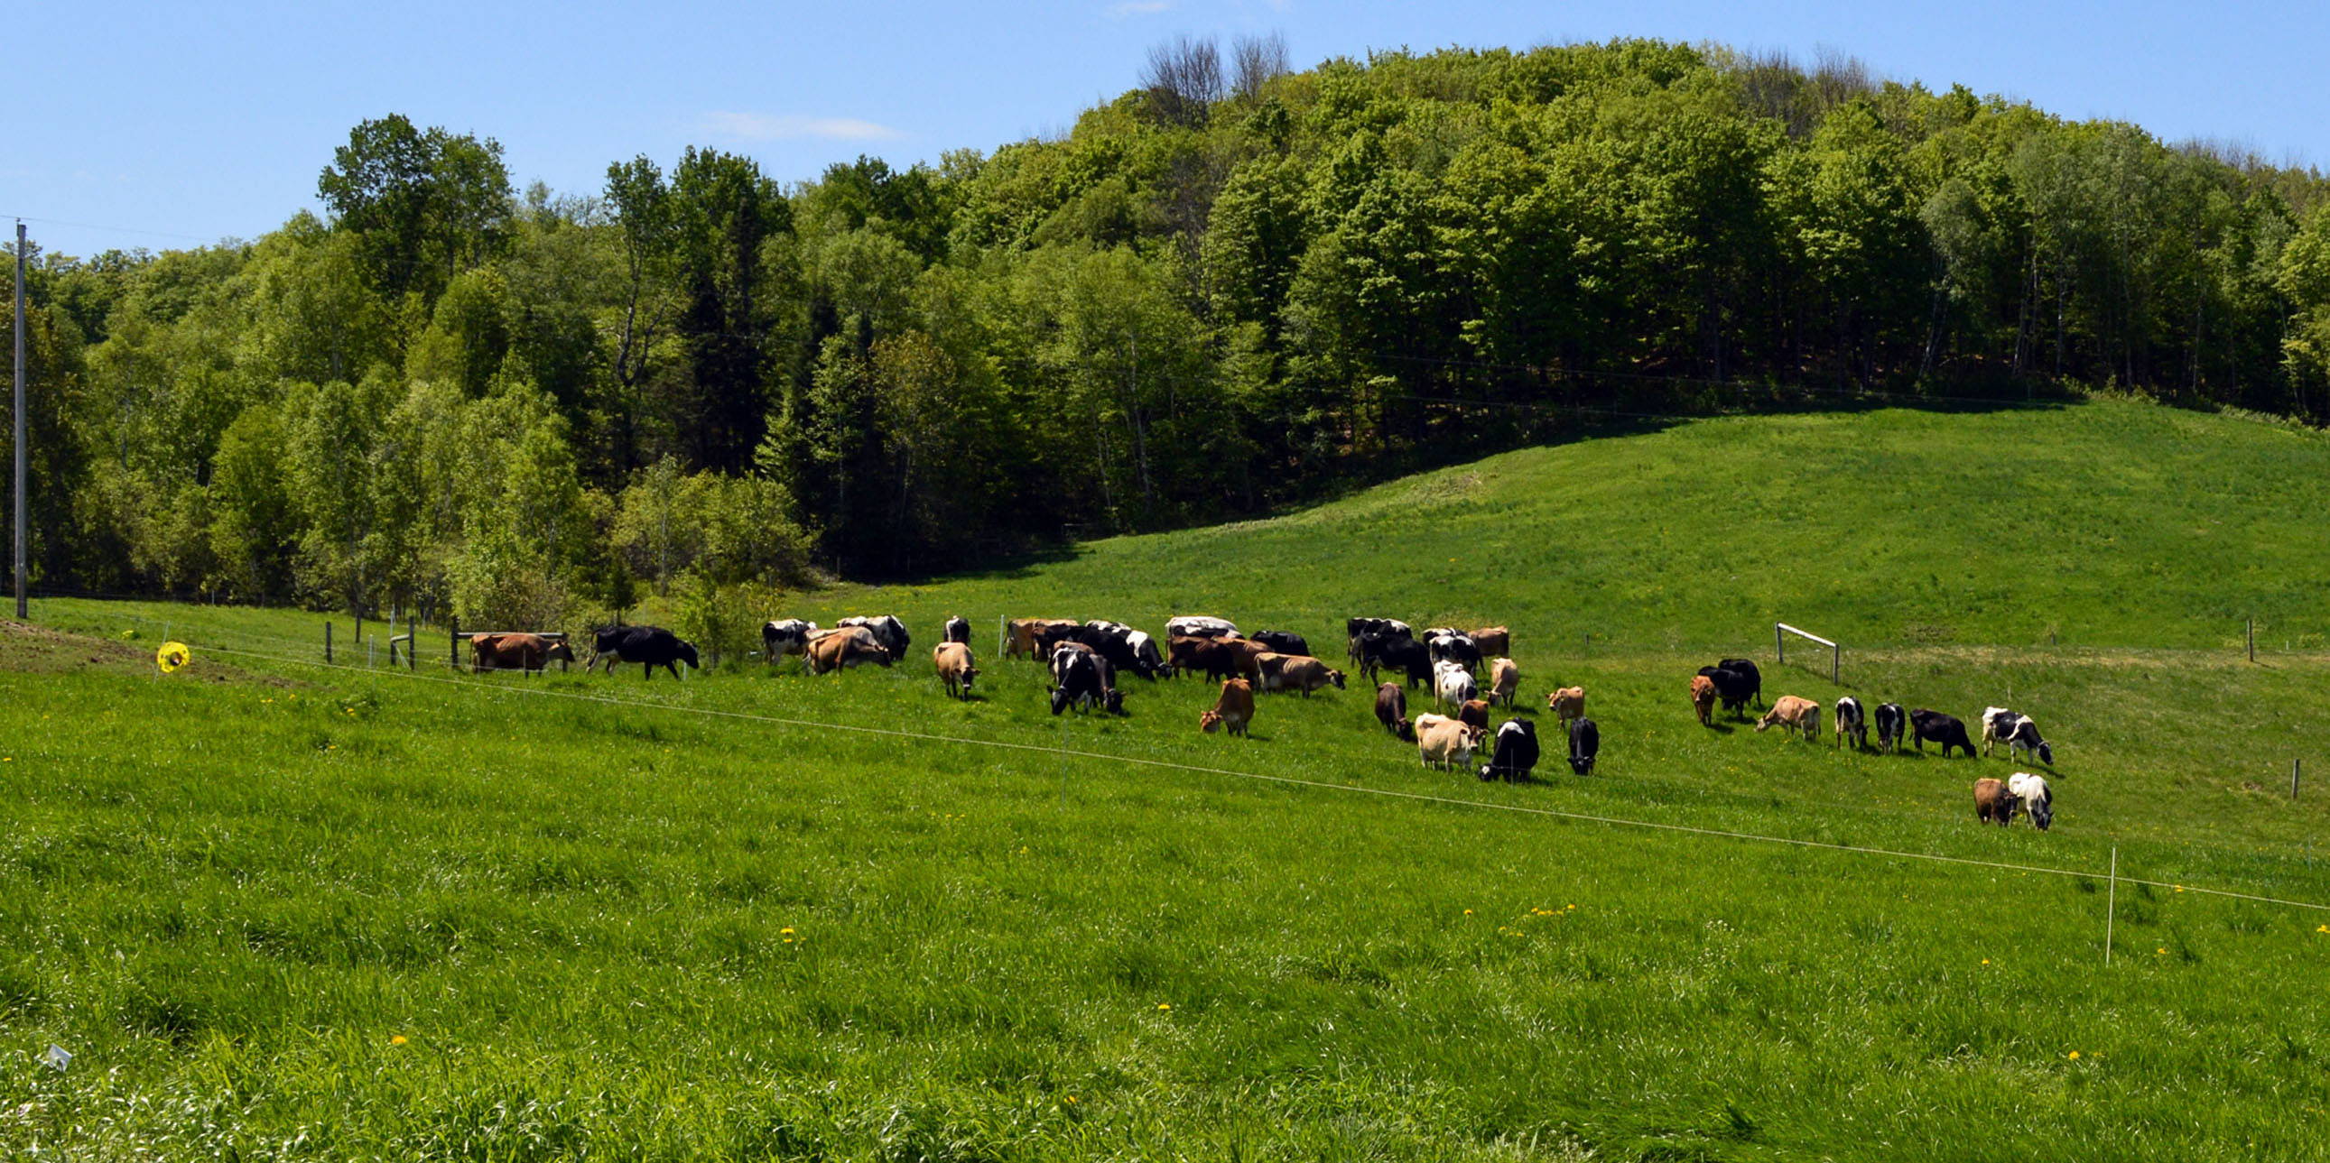
01
For consumers
Accurate & transparent

Slide 5
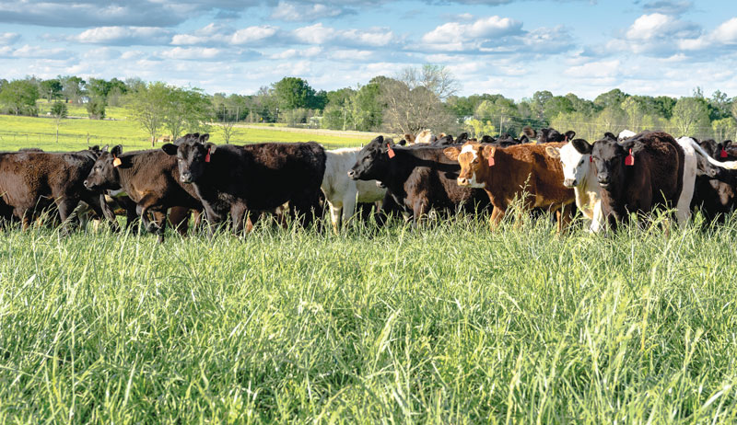
For consumers
Accurate & transparent
Get product information
Obtain production process and company information
Function expansion of information platform
Public welfare projects

Slide 6
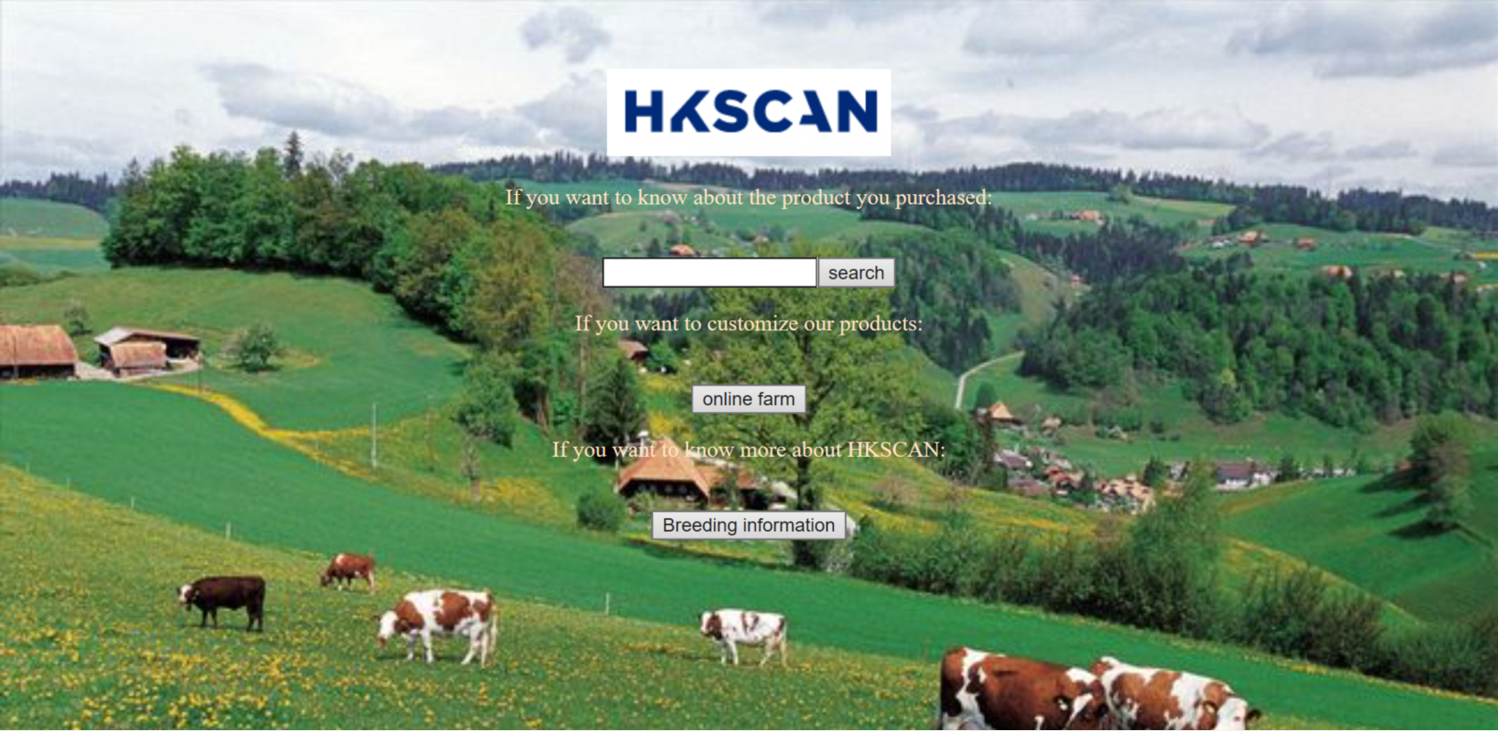

For consumers
Get product information
Add a two-dimensional code to the product, and the two-dimensional code leads to the web page with the product information. The data is used to show the production process of the product in intuitive forms such as pictures or videos, such as the breeding environment, the production environment of meat products, and the realization of data Be transparent and meet consumers' requirements for food safety, ethics and ethics.

Slide 7
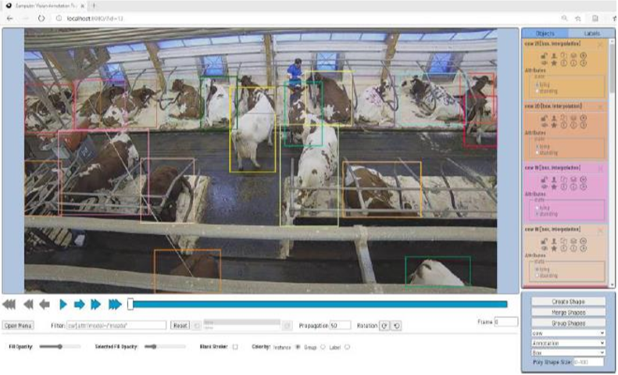
For consumers
Obtain production process and company information
Introducing the 24-hour live broadcast of farm monitoring on the high-traffic platform, where farm monitoring combined with MS Azure cloud computing technology can not only facilitate customers to directly understand the current real farm conditions, but also attract potential customers on the Internet. Through this form, users can fully understand all aspects of the breeding area, such as the breeding environment, the feed situation of feeding, and the recovery of production waste.

Slide 8
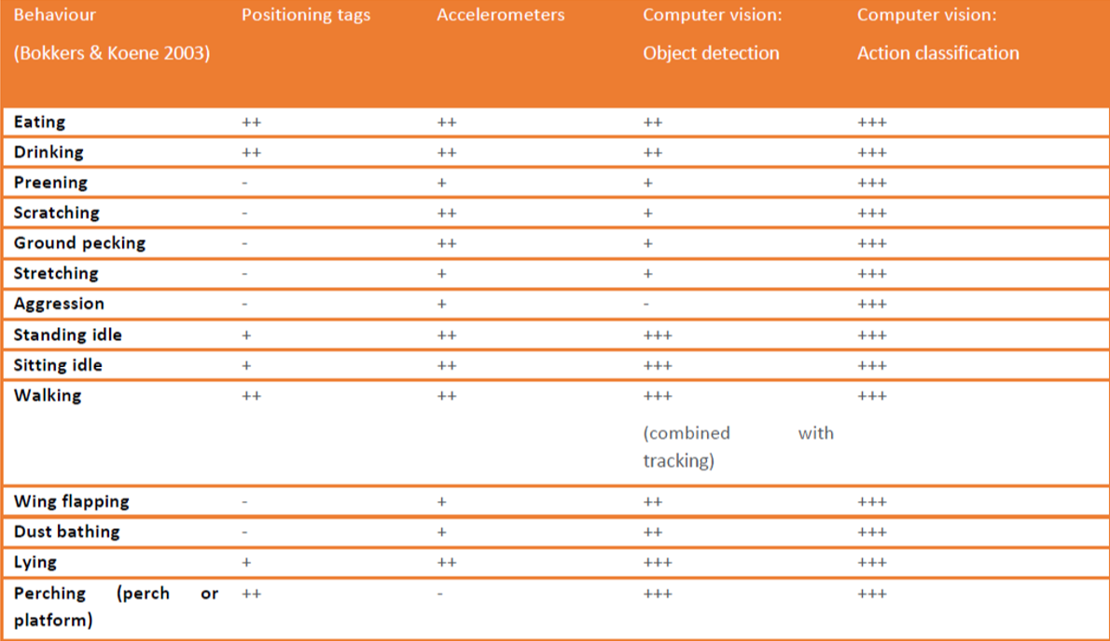
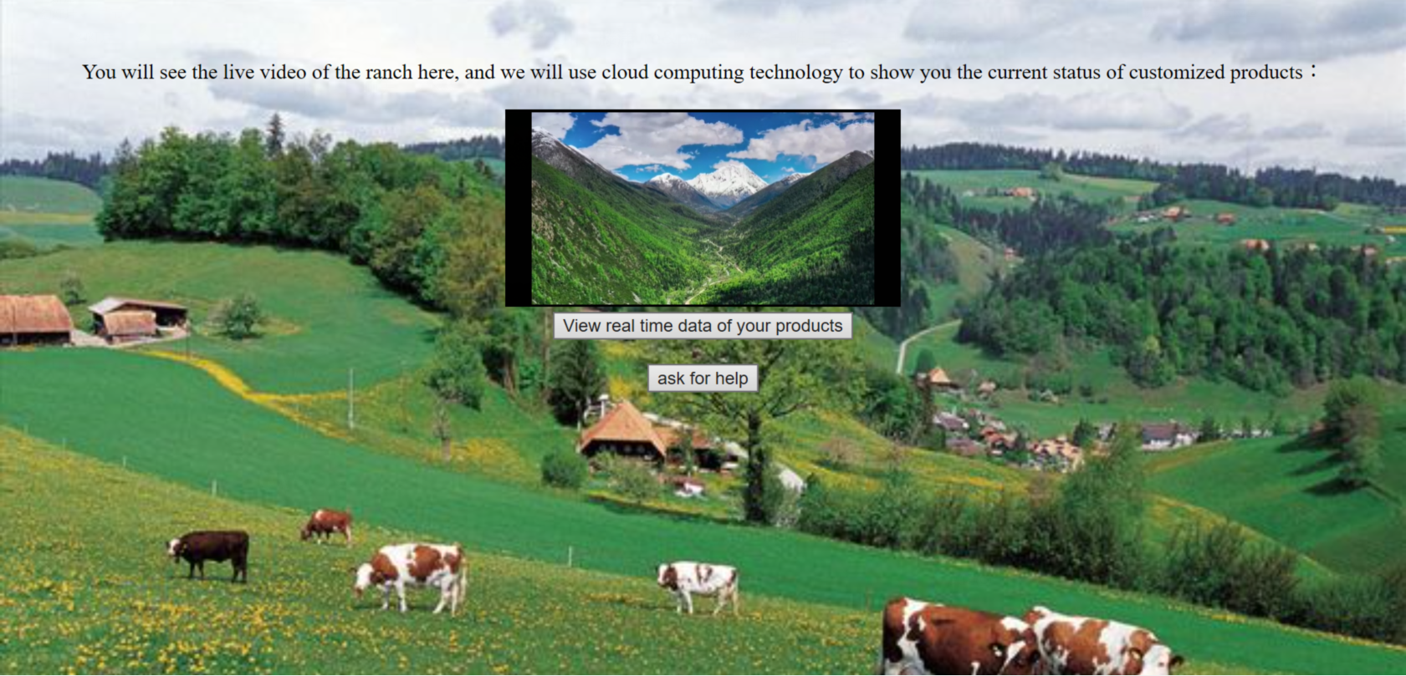
For consumers
Function expansion of information platform
Build a more interactive consumer experience, such as Cloud Farm, where the farm provides breeding programs and technical guidance (such as breed selection, breeding methods, and key points of breeding, etc.) so that consumers can participate in the production process of products. At the same time, combined with smart camera technology, consumers can see their participation in production through the platform anytime and anywhere.

Slide 9
For consumers
Public welfare projects
Help consumers understand food safety. From the breeding chain of products to processing and production to people’s tables, most consumers will ignore the hidden safety hazards and product quality. Take our own products as an example, through public welfare science or other forms to make consumers more clearly aware of food safety, on the one hand, improve consumer awareness, on the other hand, play a positive role in promoting their products.

Slide 10
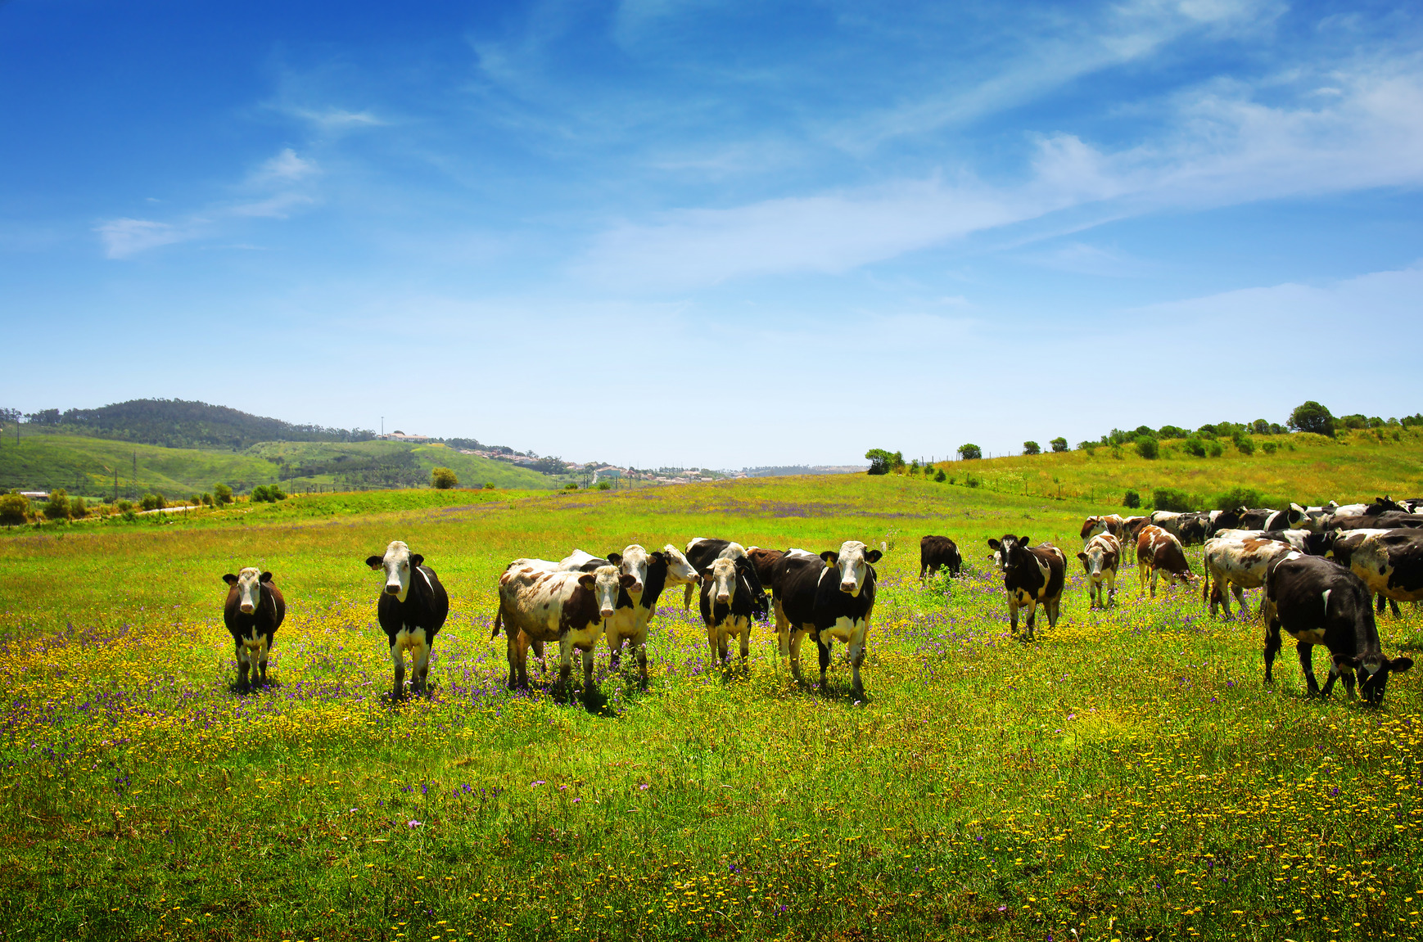
02
For ourselves
Promotion & progress

Slide 11





For ourselves
Promotion & progress
Improvement of the original product
Improve your own sales methods based on sales conditions
enjoy better products
such as organizing farm visits and shooting documentary advertisements

Slide 12
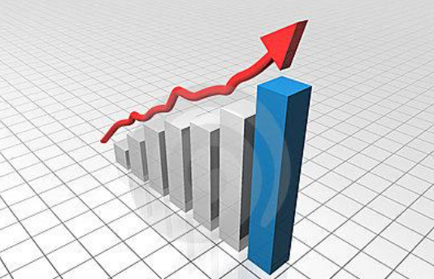
For ourselves
Improvement of the original product
We have always considered the importance of consumers in our production chain. By collecting various feedbacks from consumers and counting our sales, we will improve the production structure and production methods of our existing products in order to create a more environmentally friendly and transparent business method, so that consumers can enjoy better products .

Slide 13

For ourselves
Improve your own sales methods based on sales conditions
We believe that an open and transparent production chain and a cordial and friendly sales method are extremely important. Our farms in Northern Europe and the Baltic Sea will be open to people who are curious and eager to learn more about how we implement our concept of animal welfare. As for those customers who are far away from us but still trust us and purchase our products, we will rely on our Agrofood Ecosystem® ecosystem data to provide real-time data through our website through smart cameras and other methods, allowing customers to greatly increase their sense of participation. In addition, we will also respond to meat consumers to learn more about the more environmentally friendly and ethical meat products provided by the company through better information transparency and more facts by shooting documentary advertisements where cattle and sheep are relaxed and contented.

Slide 14
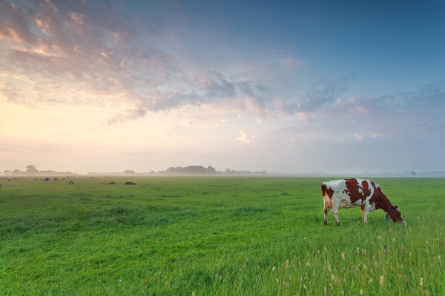
03
For the breeding chain
convenient & win-win

Slide 15

For the breeding chain
convenient & win-win
In-depth study of the best conditions for breeding, intelligent control of the needs of the breeding environment
Strictly control the source of meat quality
Strengthen cooperation with farms and pastures, and provide relevant technical and personnel support and guidance

Slide 16
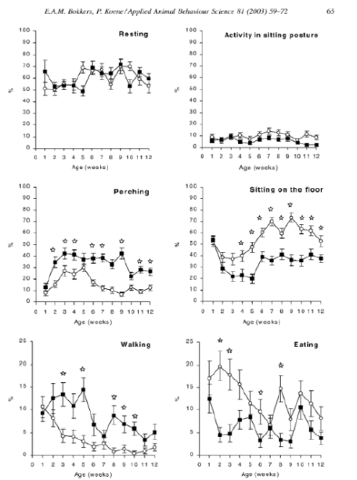
For the breeding chain
convenient & win-win
We use Agrofood Ecosystem® ecosystem data combined with machine deep learning to find the best breeding plan under any situation. While providing environmentally friendly and high-quality meat products, it also allows the farmed animals to enjoy full welfare.

Slide 17
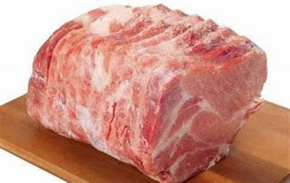
For the breeding chain
convenient & win-win
We always put the health benefits of users in a very important position. HK Scan has the entire production and consumption chain from farm to table. Only after very strict screening can it become a farm and pasture that cooperates with us. Under our automatic animal welfare monitoring, animals can grow up healthy and provide safe, environmentally friendly and delicious meat products.

Slide 18
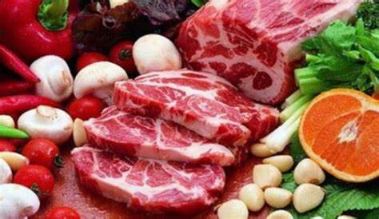
For the breeding chain
convenient & win-win
All farms and ranches that become our partnership will adopt our Agrofood Ecosystem® ecosystem and animal welfare monitoring mechanism. We will send relevant technical personnel to support and guide the cooperative farms, so that they can produce meat products that are environmentally friendly and transparent in the process.

Slide 19
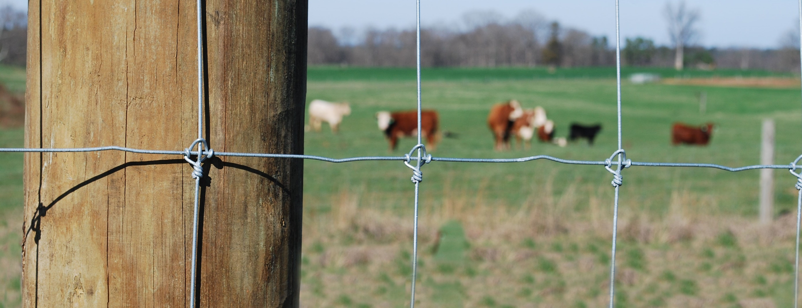
2020
THANKS

